Slide 1

CIT-2180 Data and Database Management Chapter 13

Slide 2

Oracle 12c: SQL
Chapter 13
Views

Slide 3
Views
Permanent objects that store no data
Store a query
Two purposes
Reduce complex query requirements
Restrict users’ access to sensitive data
3

Slide 4
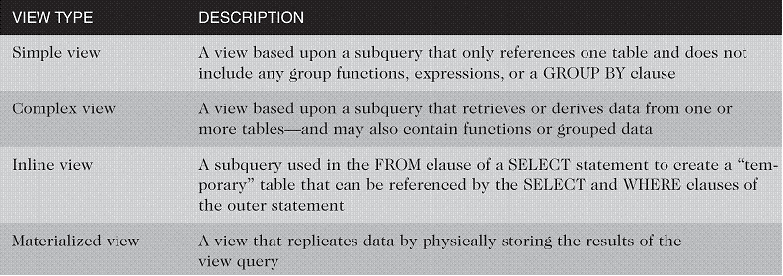
Types of Views
4

Slide 5
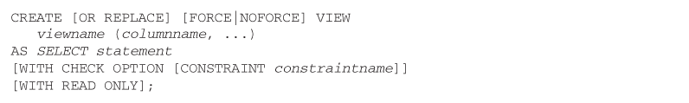
Creating a View
You use the CREATE VIEW keywords to create a view
Use OR REPLACE if the view already exists
Provide new column names if necessary

Slide 6
Creating a View (continued)
WITH CHECK OPTION constraint – if used, prevents data changes that will make the data subsequently inaccessible to the view
WITH READ ONLY – prevents DML operations
6

Slide 7

Creating a Simple View
Only references one table – no group functions, GROUP BY clause, or expressions

Slide 8
DML Operations on a Simple View
Any DML operations are allowed through simple views unless created with WITH READ ONLY option
DML operations that violate constraints on the underlying table are not allowed
8

Slide 9

Creating a Complex View
A complex view may contain data from multiple tables or data created with the GROUP BY clause, functions, or expressions
Type of DML operations allowed depends on various factors

Slide 10
create view prices as select isbn, title, cost, retail, retail-cost profit from books;
The following DML statements generate errors.
delete from prices where …;
insert into prices values (…);

Slide 11
Summary guidelines for DML operations on complex views
Can’t violate a constraint
Can’t add to a column that is an arithmetic expression
DML aren’t permitted on non-key-preserved tables
DML aren’t permitted on views that include group functions, GROUP BY, DISTINCT

Slide 12
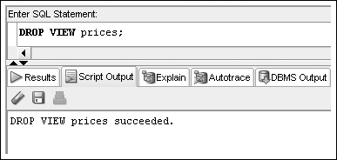
Dropping a View
Use DROP VIEW command

Slide 13
Oracle 12c: SQL
END OF Chapter 13
Views

